Slide 1
Dashboard Storyboard

Slide 2
What Data We Want to Show
Trend of Sales over a period of time
Scatterplot with a correlation of number of sales to the review score
A heat map of sales per region (interactive)

Slide 3
Description of interactive element(s)
A Heatmap showcasing the sales of each of the major regions (US, EU, JP)
Cursor to hover over each of the regions
A tab to select the year
A drop down menu to select certain game titles to look how they performed visually in each region

Slide 4
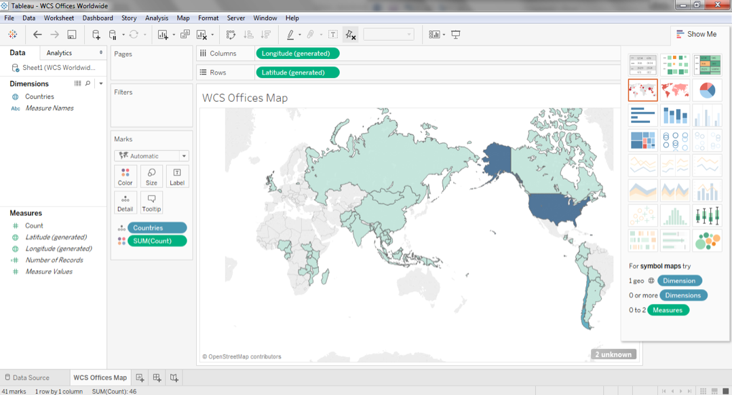
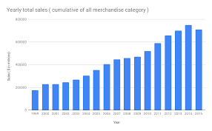
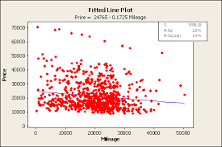
Examples of Charts we want to show

Slide 5
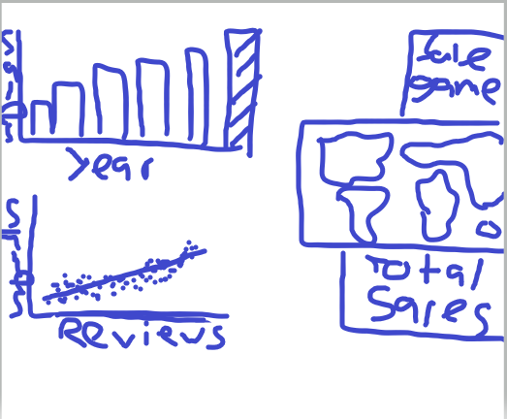
Rough 1st iteration of dashboard

Slide 6
What tools we will be using
We plan on making our dashboard through Tableau

